Slide 1
Real Talk
OG COYOTES: NOSQL
Allison Young, Alan Zhou, Abhishek Angadi, Frank Xu

Slide 2
1) Overview

Slide 3
2) Research Questions

Slide 4
What do these users talk about most often?
(explore /frequency/topics)
2. Do different subgroups talk about different topics? --- (sub setting/metadata)
Do different subgroups talk about the same topics differently?
(psychometrics)

Slide 5
3) Data Elements

Slide 6
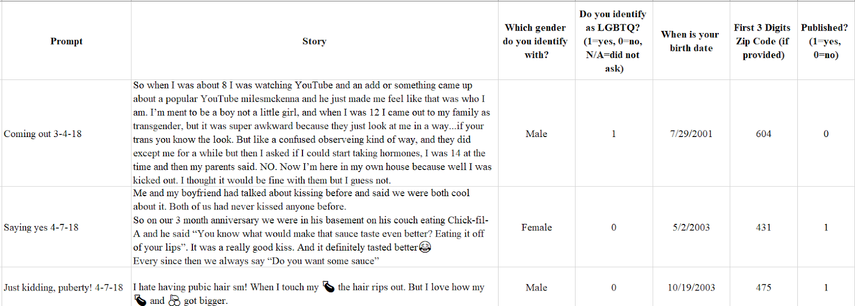

Slide 7
4) Top 20 words

Slide 8
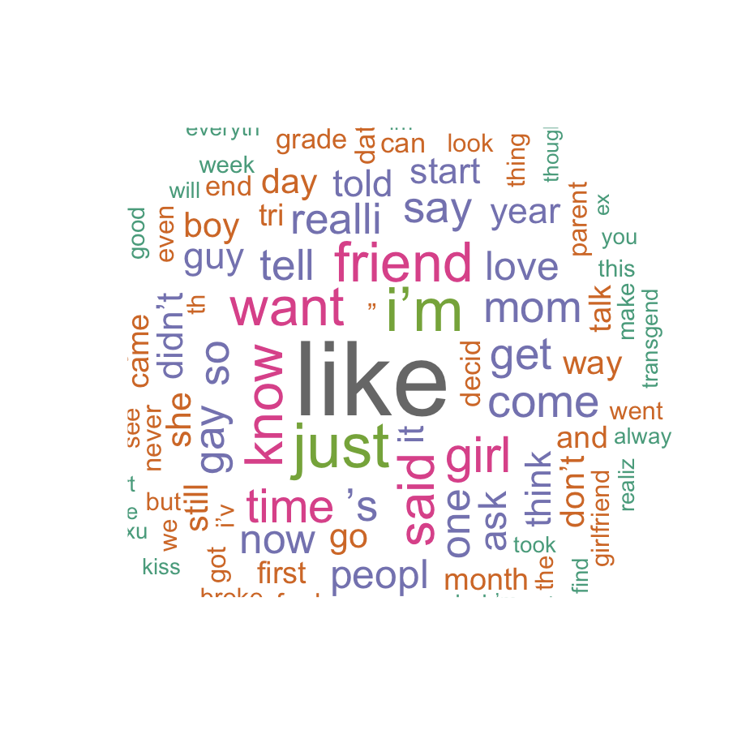
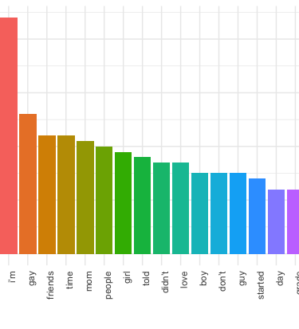
tm
tidytext

Slide 9
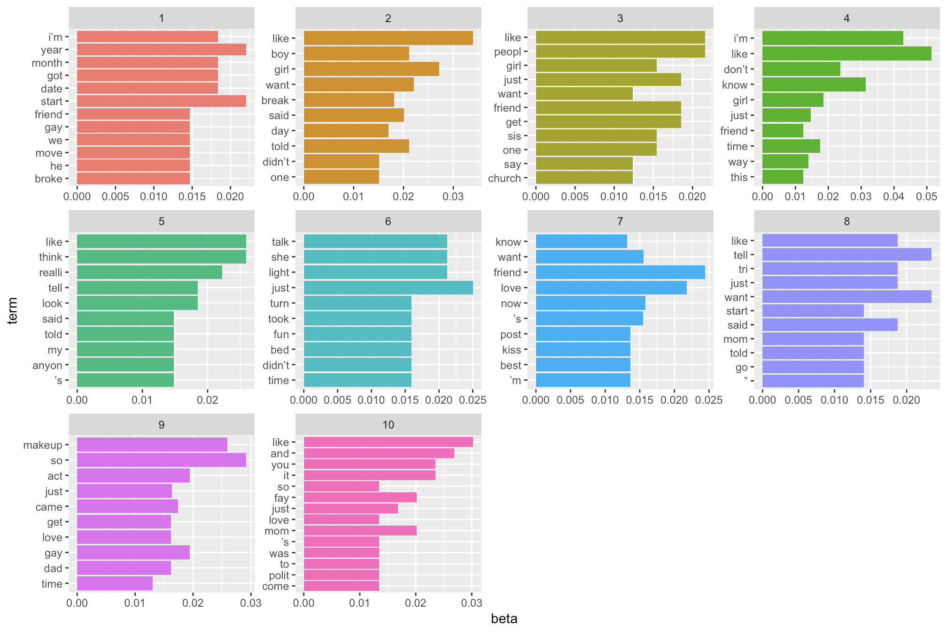
tm (topic modeling)
-stop words
-numbers and punctuation
-lowercase
-stemming

Slide 10
Questions for Class
Are there additional methods we should consider in answering these research questions?
Are there additional ways in which you believe we can assist Liz in this work?

Slide 11
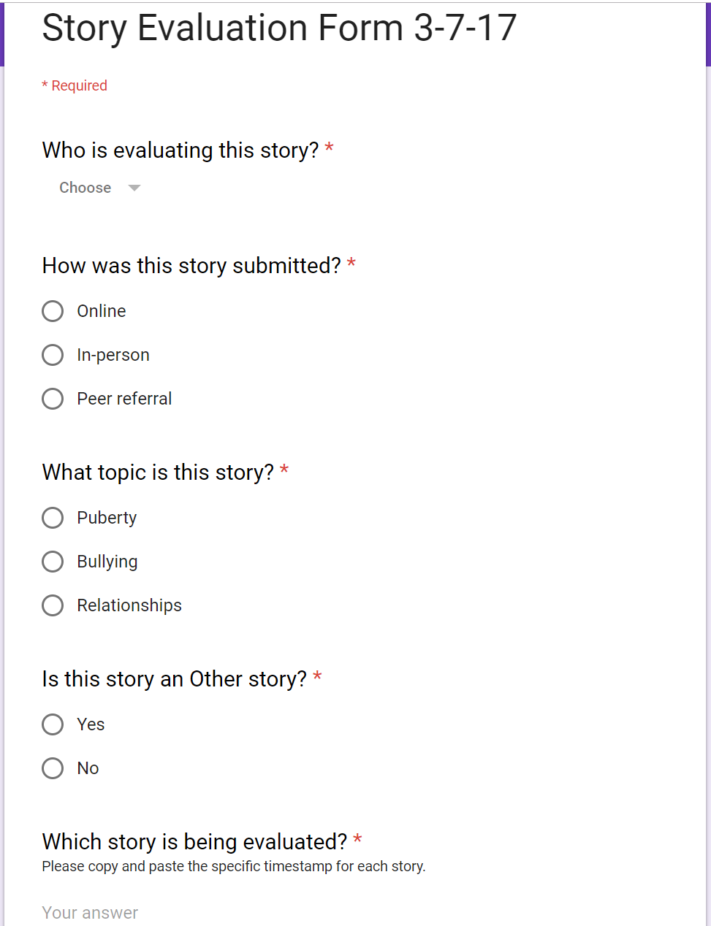
Evaluation Form

Slide 12
